Slide 1
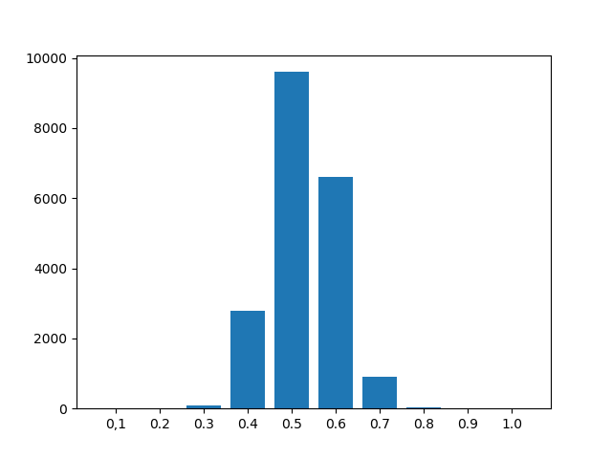
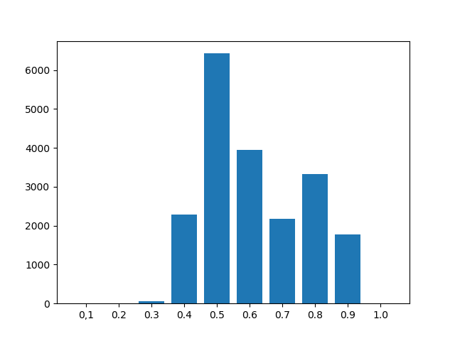
Last Week
This Week
Deep Learning Neural Network Training Data Preparation
MSTA 2019 포스터 (7/31)
삼성산학과제 보고서 (8/1)
Neural Network Model Training

Slide 2
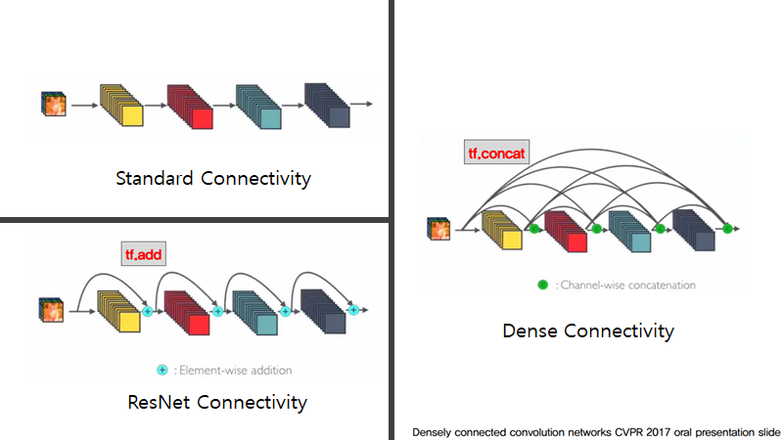
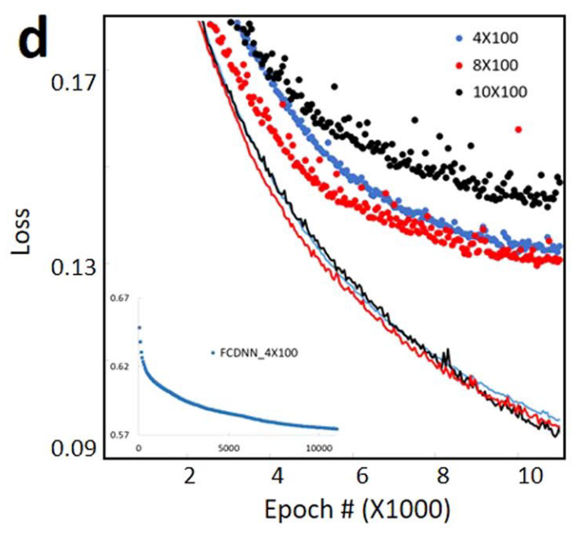
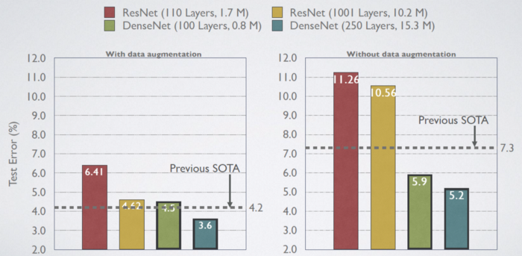
Paper
Without Nerual Network, Reinforcement Learning
ARLA (Additive Reinforcement Learning Algorithm)
현재 사용 중인 알고리즘
결과물: 1D DBR, 2D Splitter (symmetry)
With Neural Network, Supervised Learning Regression
FCDNN (Fully Connected Deep Neural Network)
ResNet (Residual Network)
DenseNet (Dense Network)
구현 중
DenseNet을 이용한 논문은 없음
Classification Performance Test
FCDNN ref.1 : A. da Silva Ferreira et al. "Computing Optical Properties of Photonic Crystals by Using Multilayer Perceptron and Extreme Learning Machine," Journal of Lightwave Technology, 2018
FCDNN ref.2 : Dianjing Liu et al. “Training Deep Neural Networks for the Inverse Design of Nanophotonics Structures," ACS Photonics, 2018
ResNet ref. : Mohammd H. Tahersima et al. “Deep Neural Network Inverse Design of Integrated Photonic Power Splitters,” Scientific Reports, 2019

Slide 3
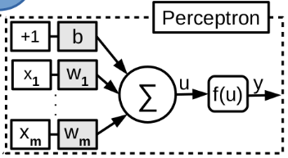
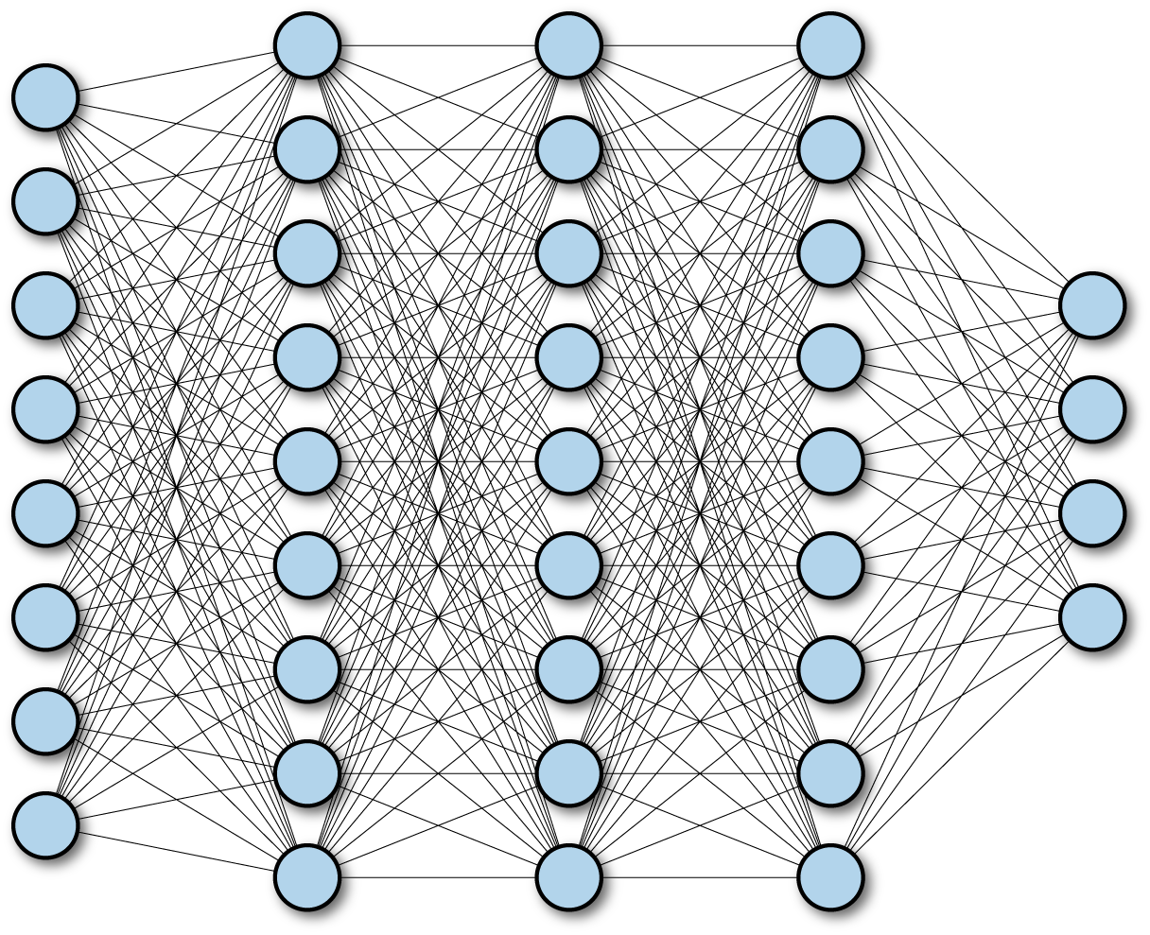
Neural Netowrk
FCDNN (Fully Connected Deep Neural Network)
Layer
Input
Output
ResNet (Residual Network)
Layer
1
Layer
2
Layer
3
Layer
4
Input
+
+
Output
DenseNet
Dense Block
Layer
1
Layer
2
Layer
3
Layer
4
Input
[+]
[+]
[+]
[+]
Output

Slide 4
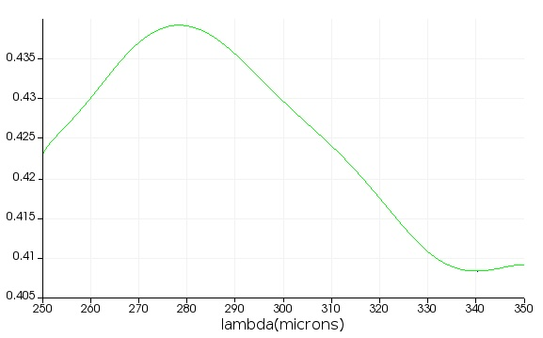
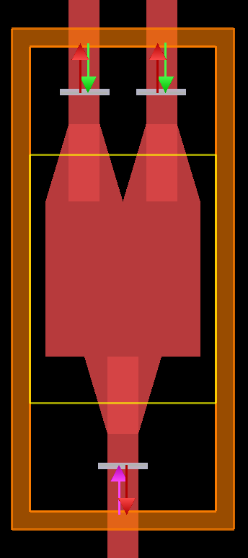
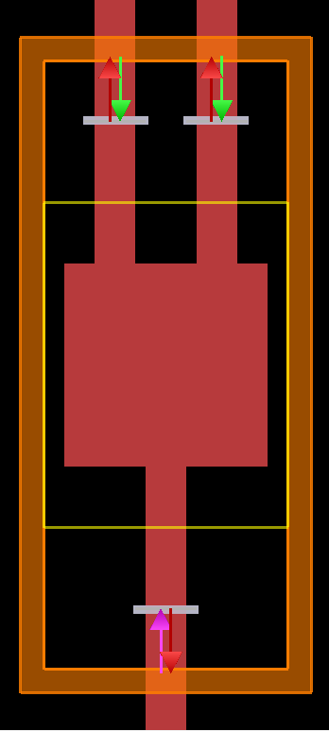
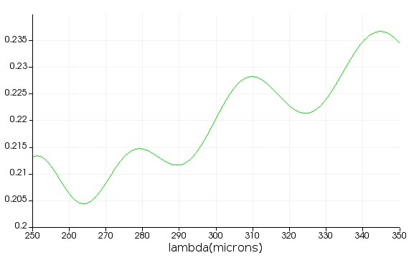
2D Power Splitter – FDTD Setting
Output 1&2
(b)-1
(a)-1
(a)-2
~ 0.4
(b)-2
~ 0.2
Simulation region: 250 ~ 350 um
Waveguide thickness: 100 um
Square: 500 um x 500 um
Taper connection: 250 um
Holes: 20x20 with a radius of 9 um

